Slide 1


Det 842 Clubs
Air Force ROTC Detachment 842
The University of Texas at San Antonio
23 Aug 24

Slide 2


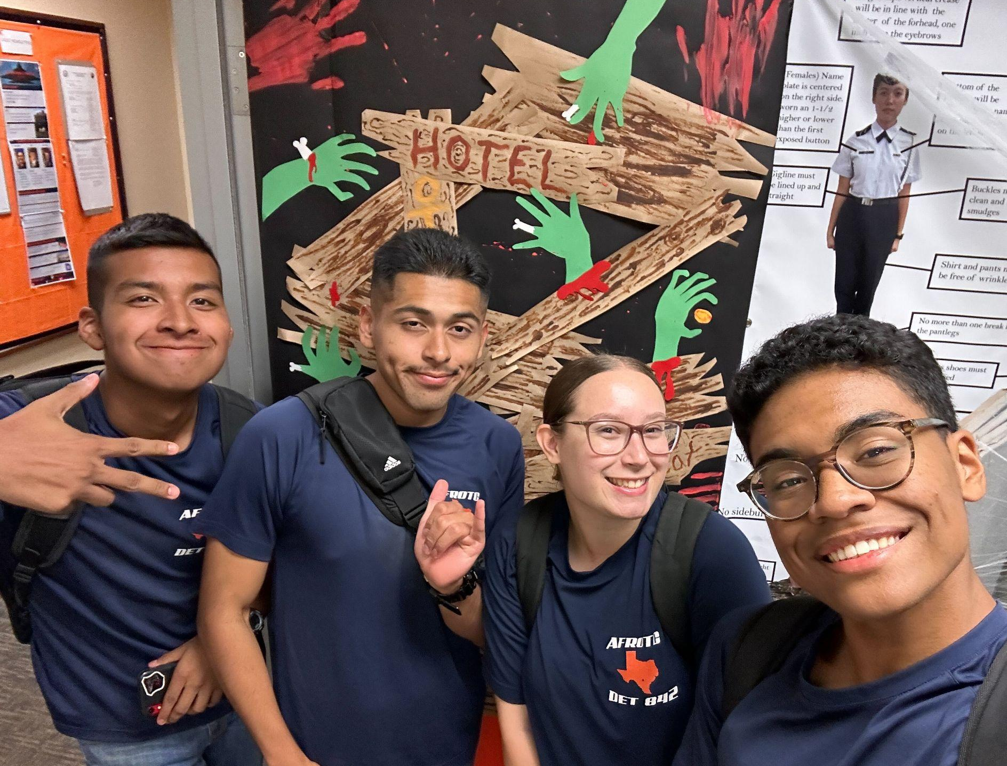
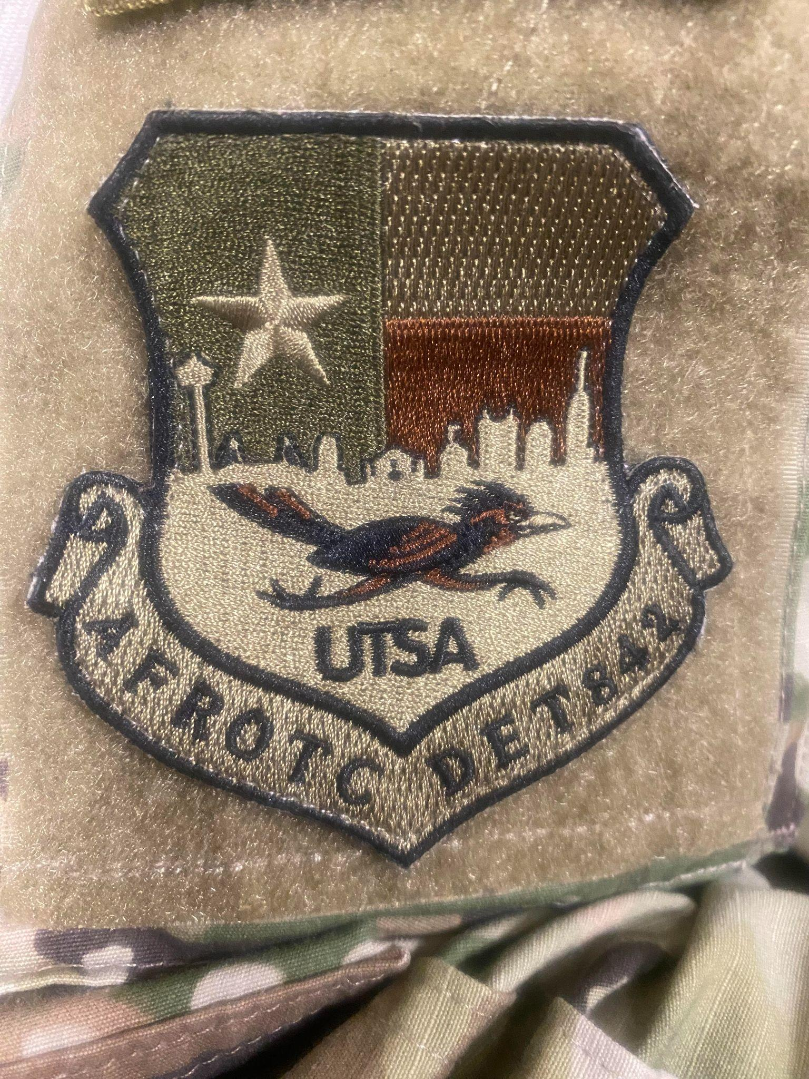
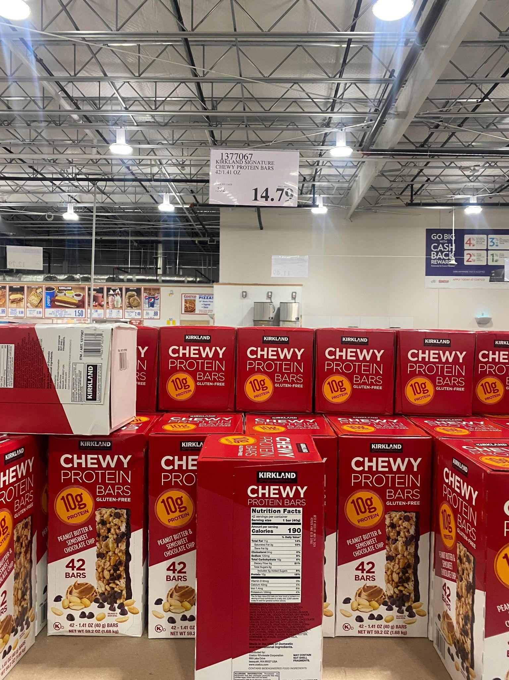
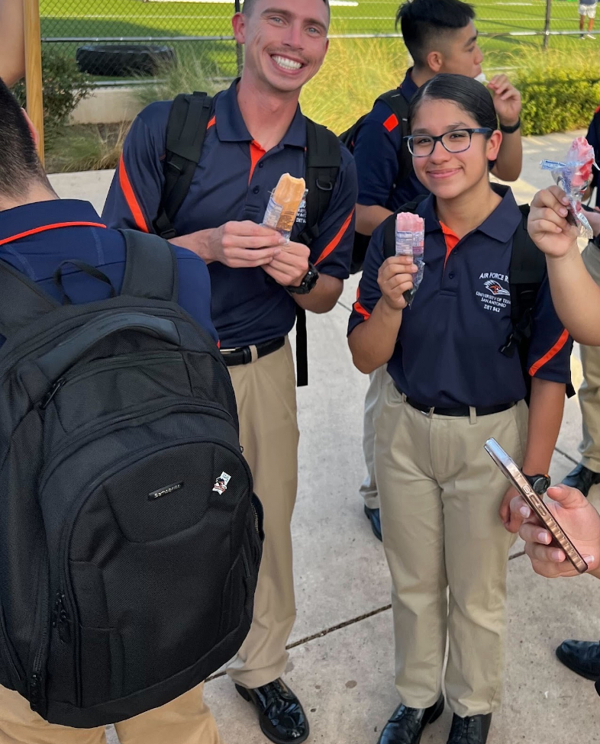
Booster Club
Socials / Events
Snack Lounge
Positions
President
Vice President
Events Officer
Sales Officer
Snack Officer
Photographer
Morale
Air Force ROTC Detachment 842 • We Build Exceptional Officers • The University of Texas at San Antonio

Slide 3
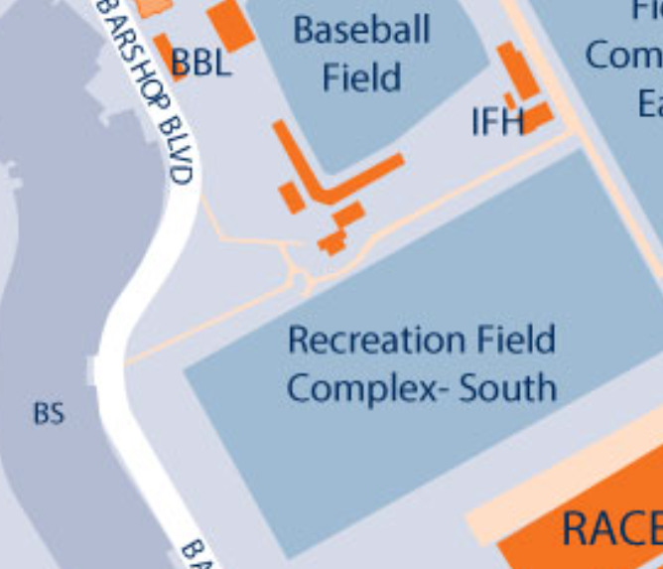
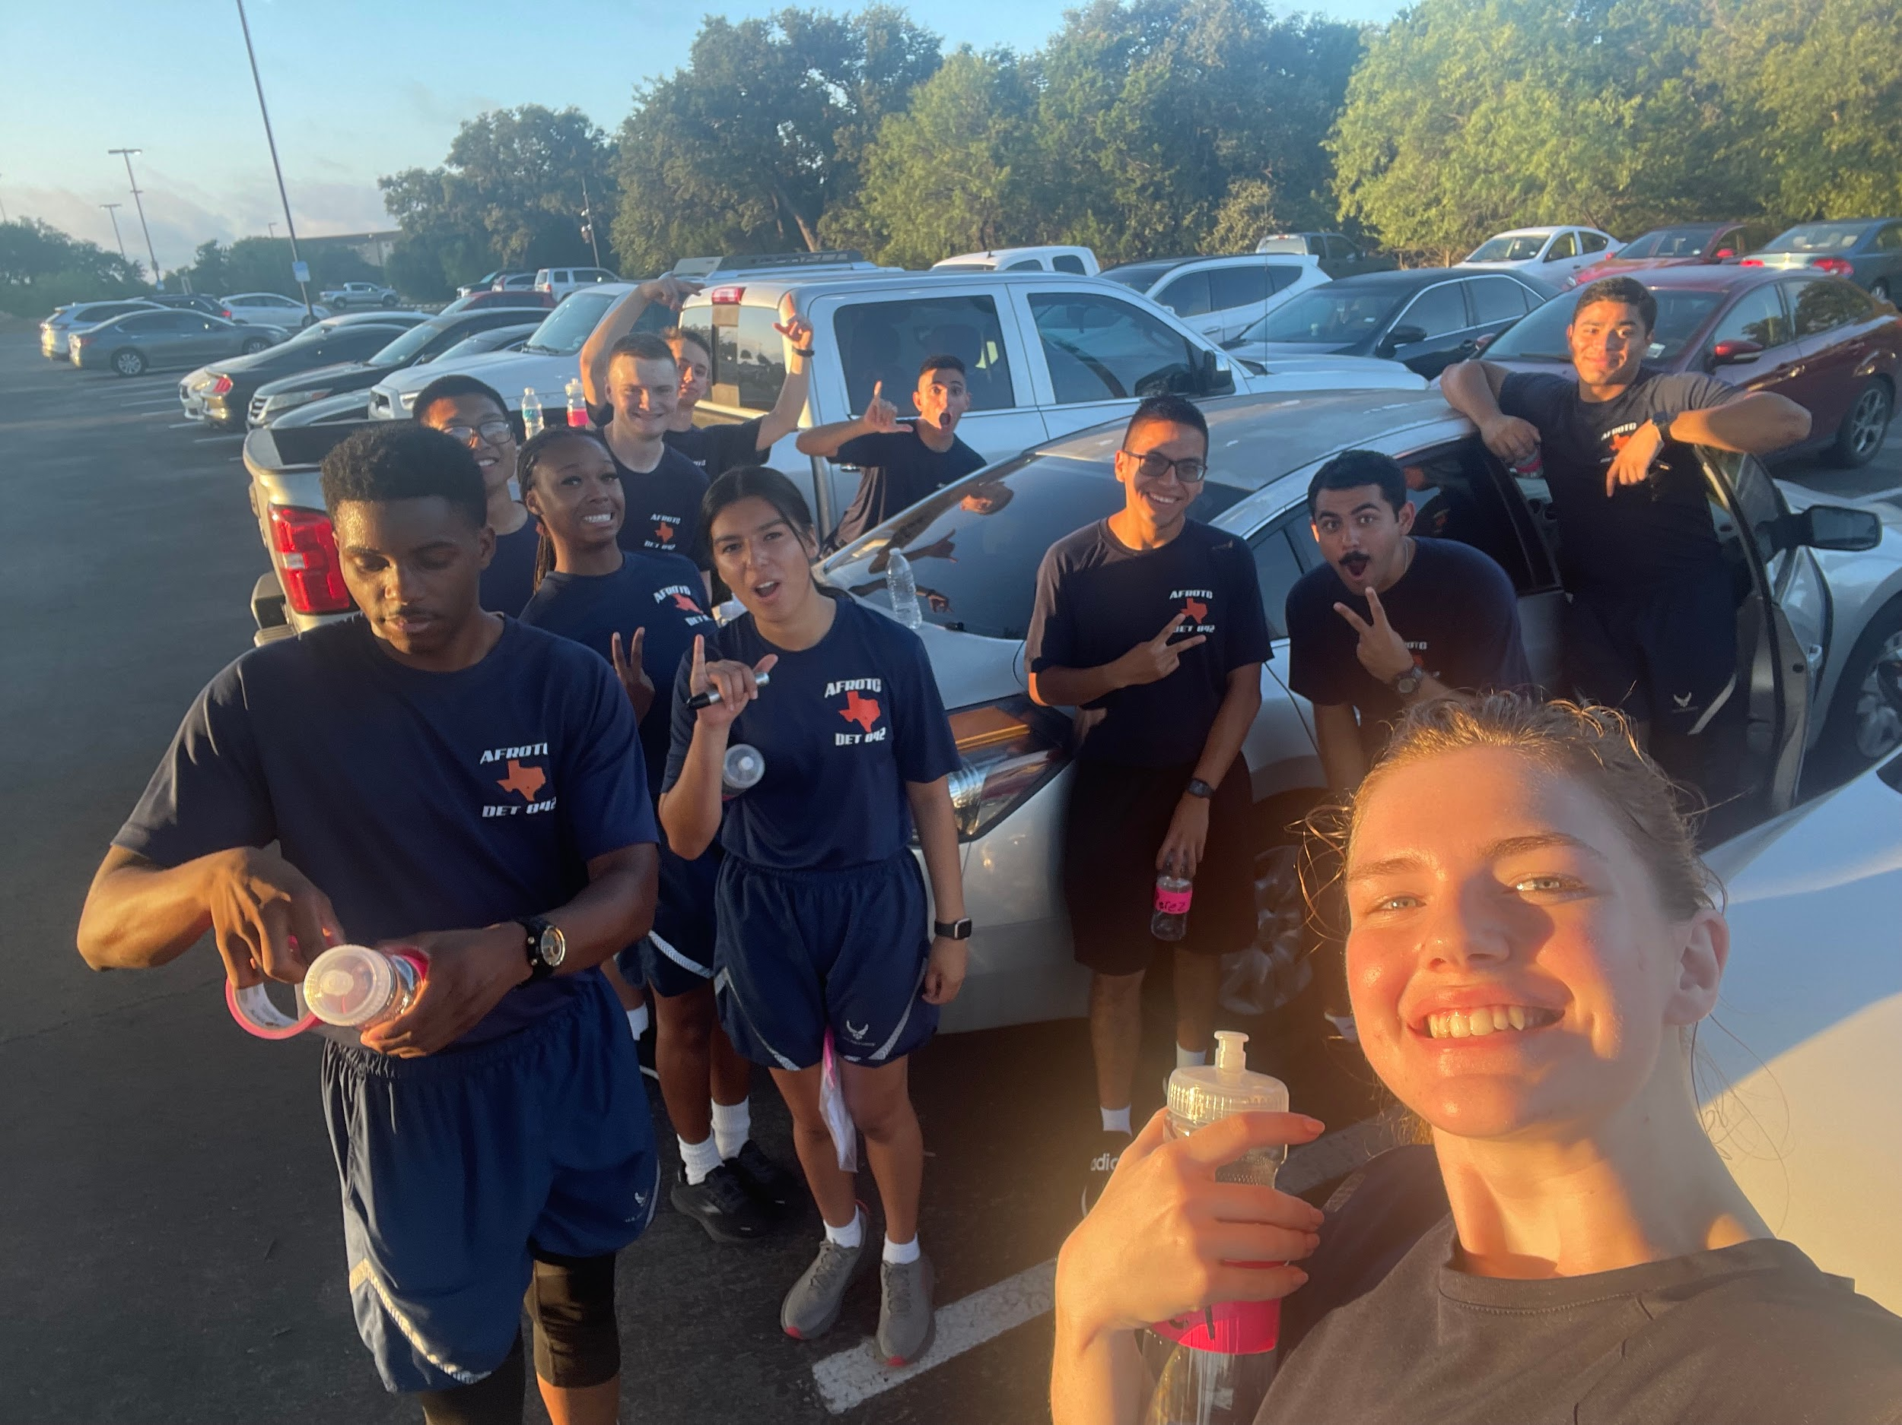

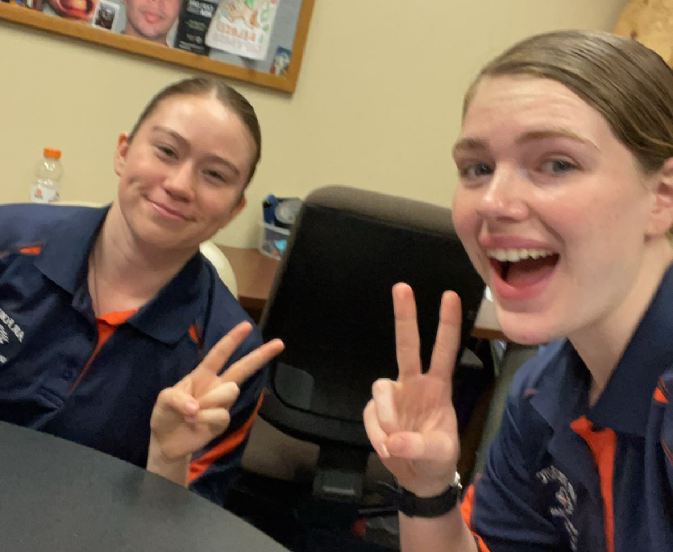
Victory
Victory Club’s Objective
Volunteer Opportunities
‹#›
Air Force ROTC Detachment 842 • We Build Exceptional Officers • The University of Texas at San Antonio

Slide 4




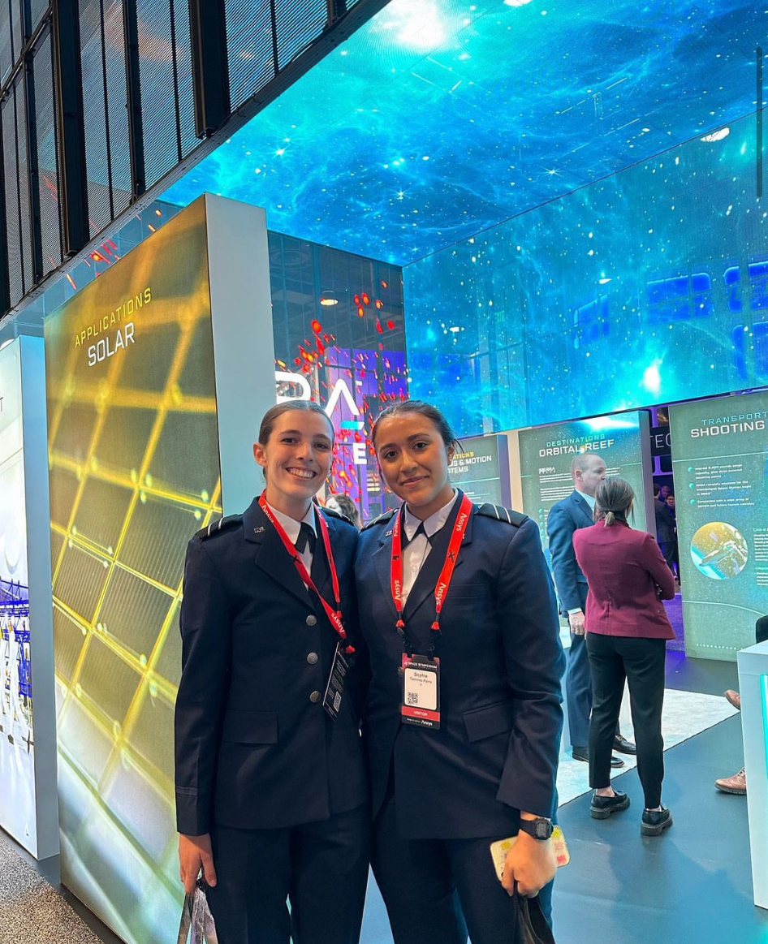
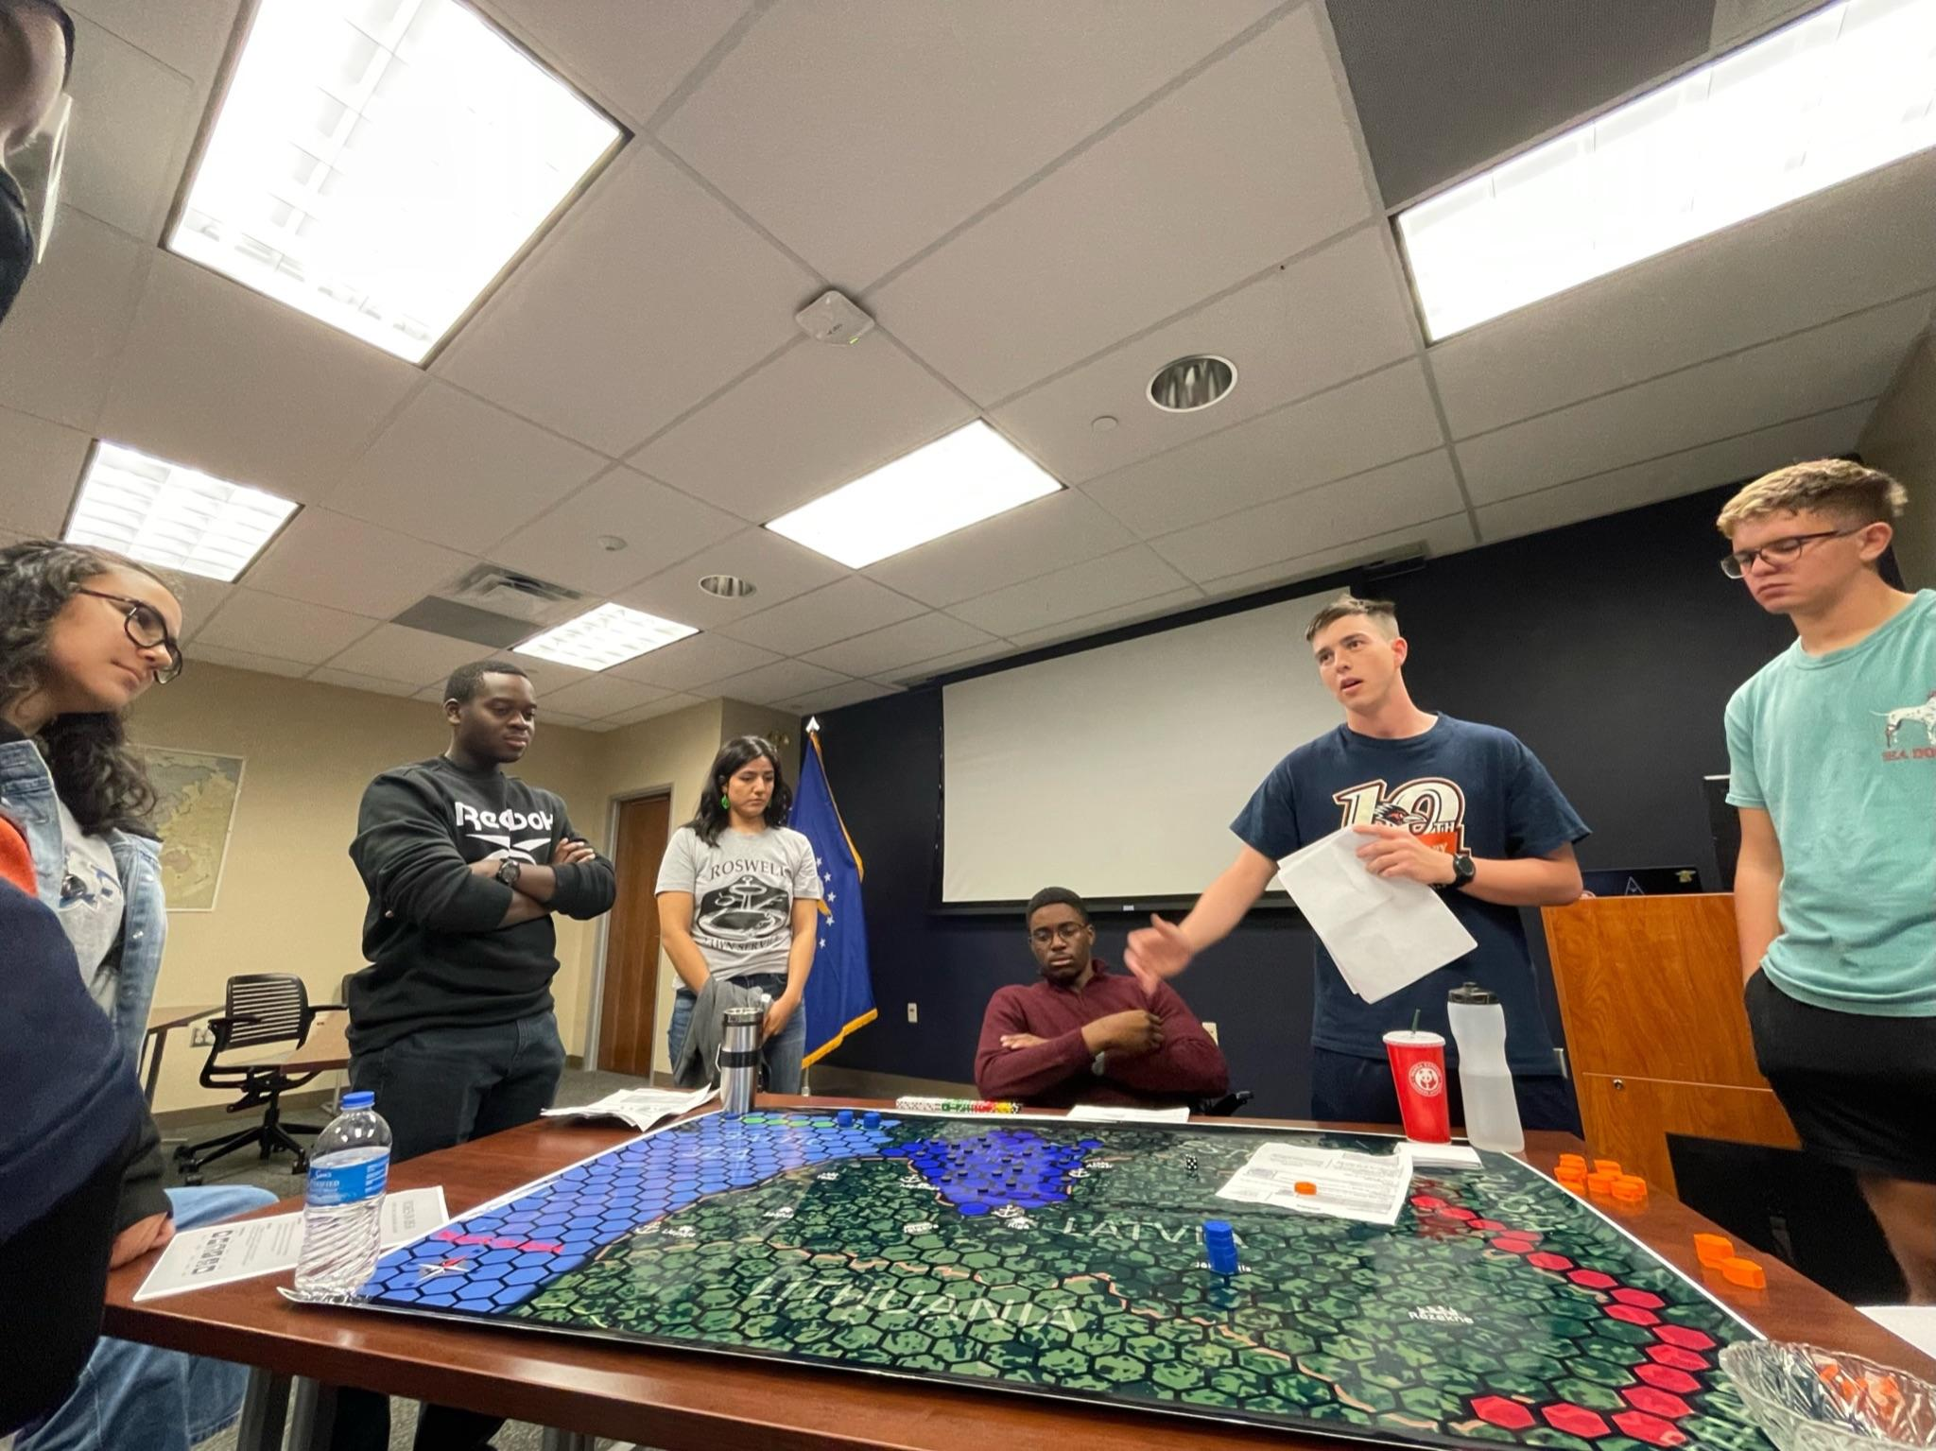
“To educate, inspire, and produce leaders that are prepared to define the character of warfighting in space.”
Register at: https://www.i5space.com/
Join us in our slack channel
Instagram: i5_det842
Air Force ROTC Detachment 842 • We Build Exceptional Officers • The University of Texas at San Antonio

Slide 5
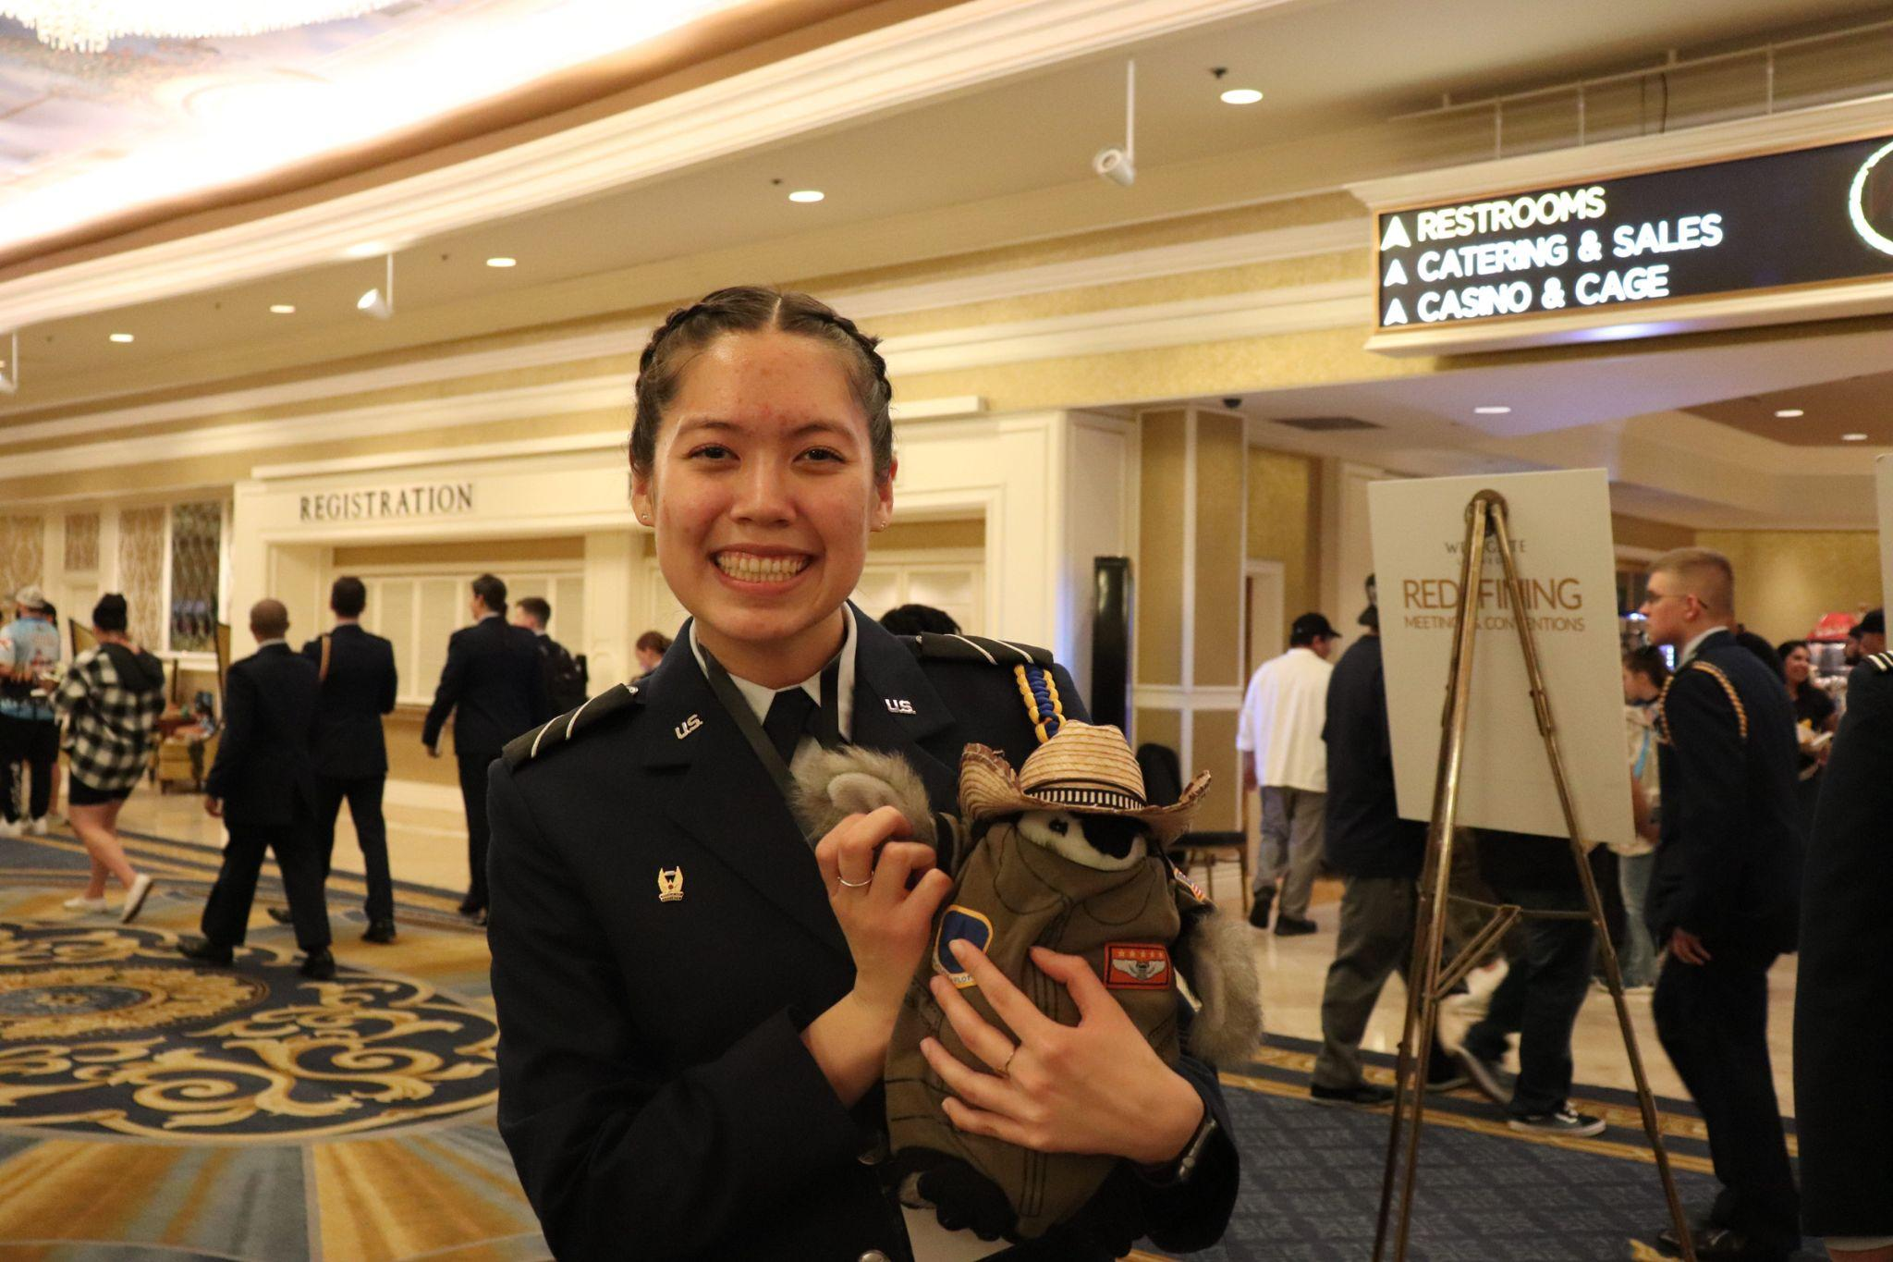
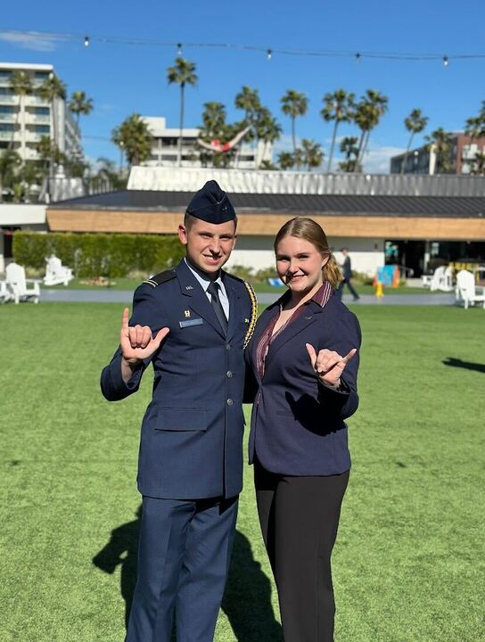

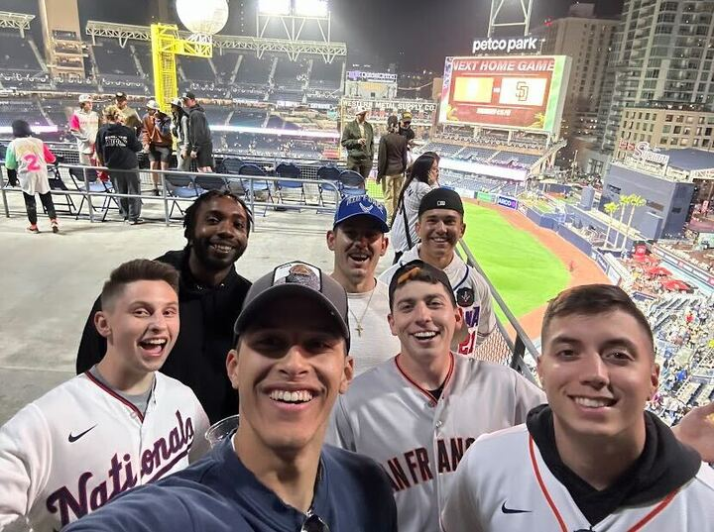
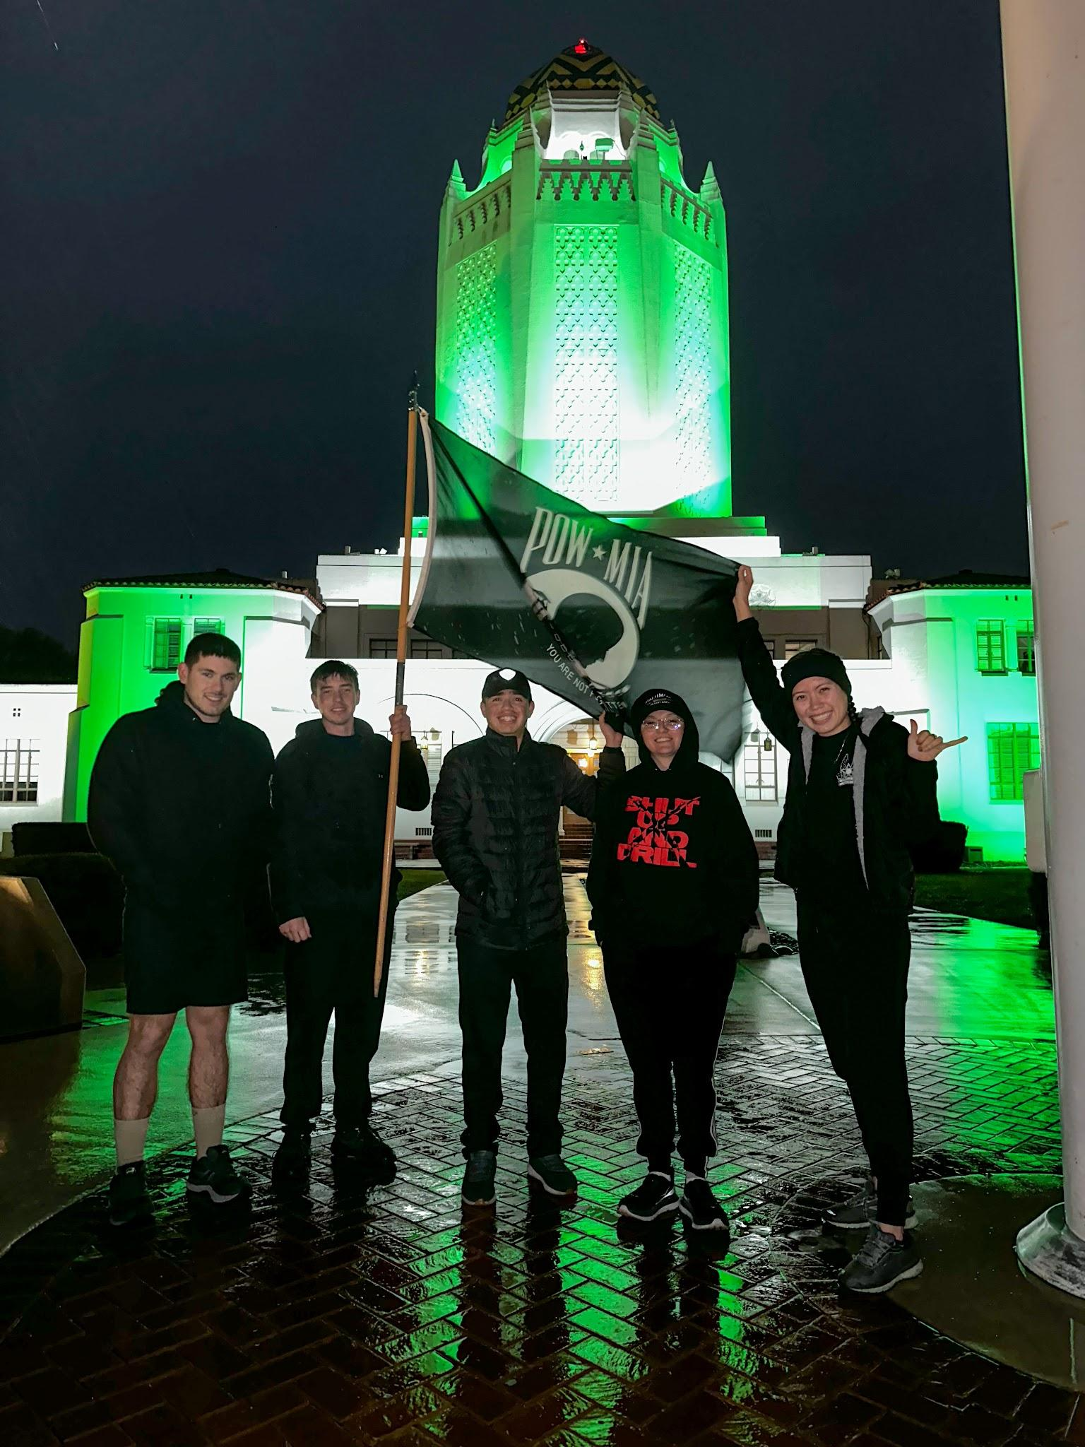
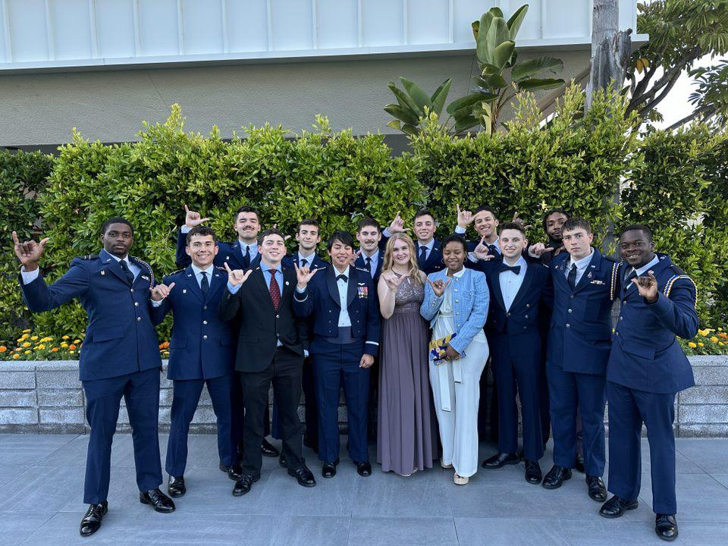
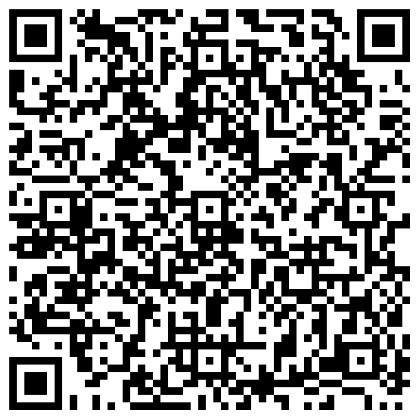
Arnold Air Society
“The Warrior Who Cultivates His Mind Polishes His Arms” - Duc De Boulfflers
QR code
https://photos.google.com/u/2/share/AF1QipPmtTZBSr2cfMtTaUBt0zVxm620yN9wcXx79NBpKzdKH33jjFsfwDnG_nl0FuYtJQ/photo/AF1QipMJZzt91mRUT_2xsaJaHKLcqkL6ffPfhrv2LXZ7?key=RDA5NmFkbjJxM21LbWRhajFuVkYtVGpfR1ktb2RR
Air Force ROTC Detachment 842 • We Build Exceptional Officers • The University of Texas at San Antonio
Notes:
https://photos.google.com/u/2/share/AF1QipPmtTZBSr2cfMtTaUBt0zVxm620yN9wcXx79NBpKzdKH33jjFsfwDnG_nl0FuYtJQ/photo/AF1QipMJZzt91mRUT_2xsaJaHKLcqkL6ffPfhrv2LXZ7?key=RDA5NmFkbjJxM21LbWRhajFuVkYtVGpfR1ktb2RR End Video at 2.44

Slide 6

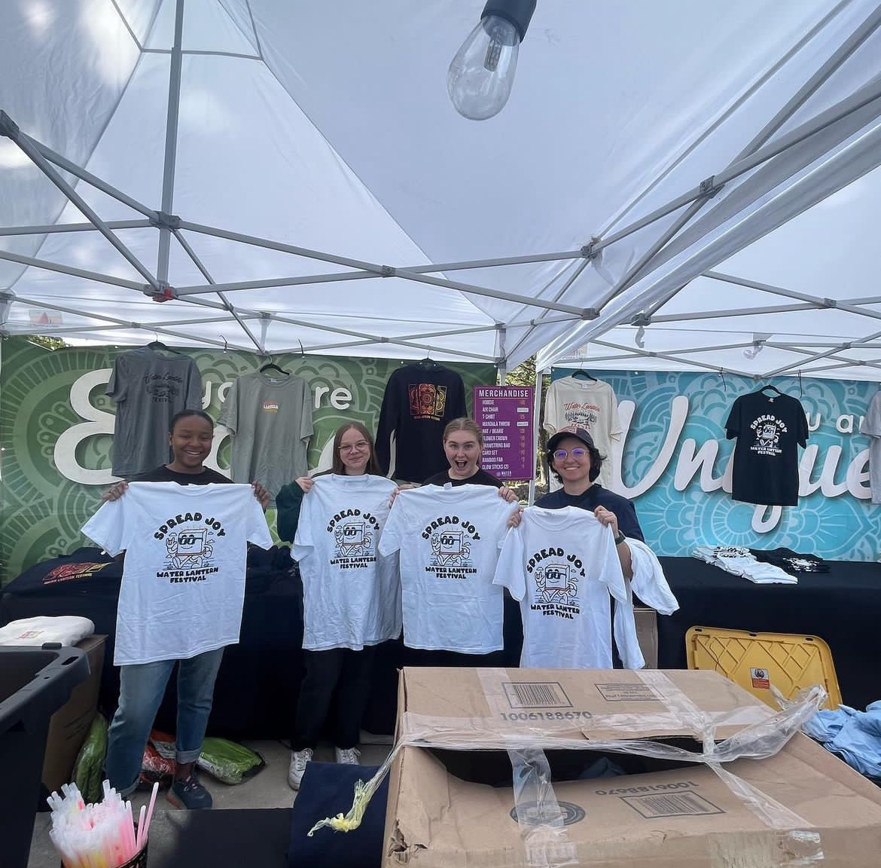
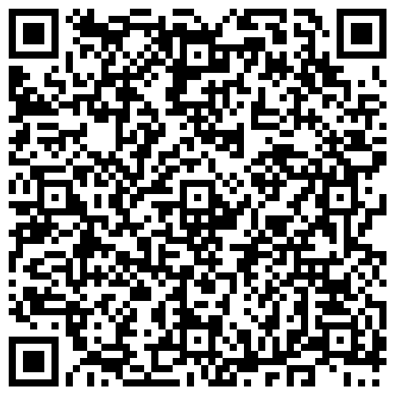
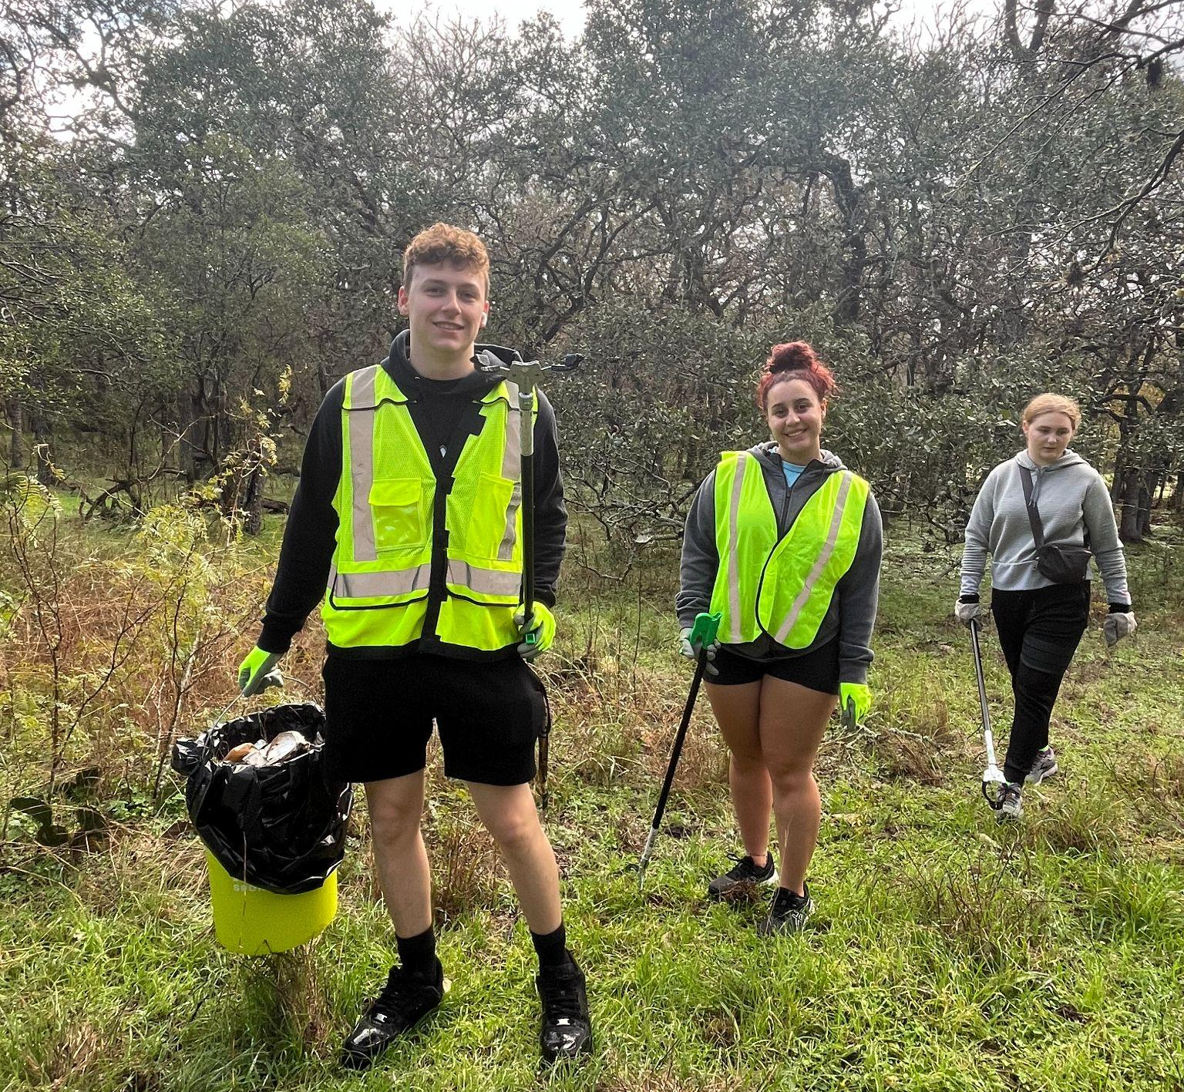
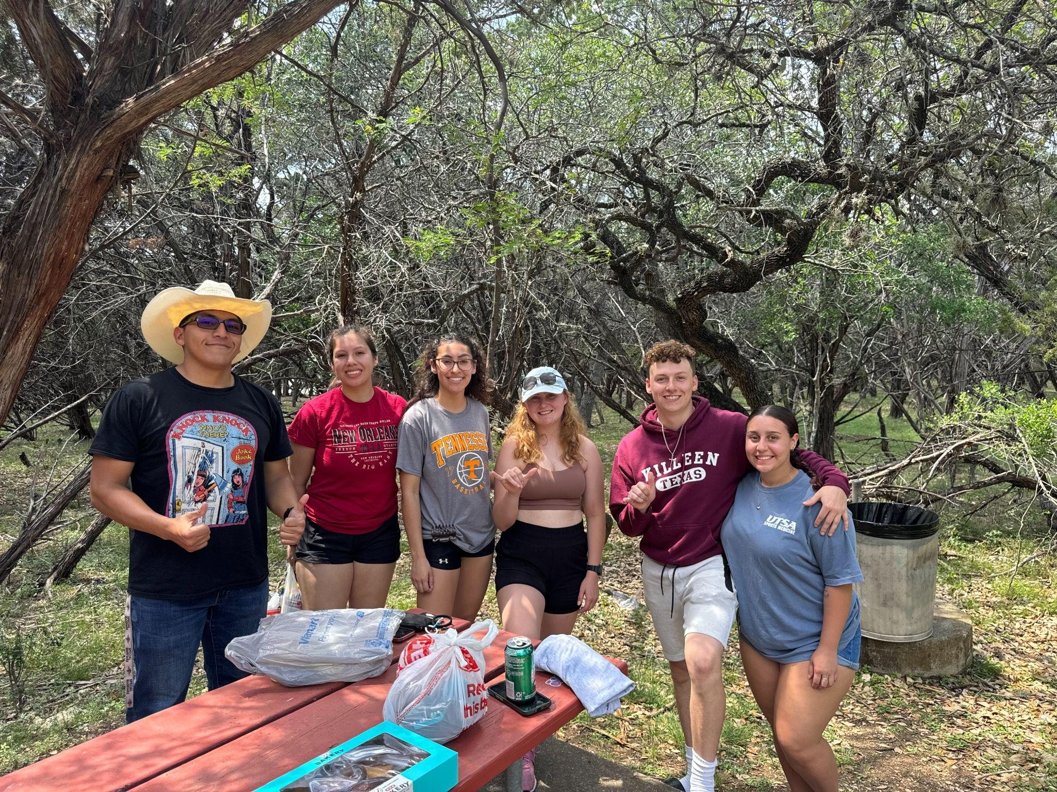
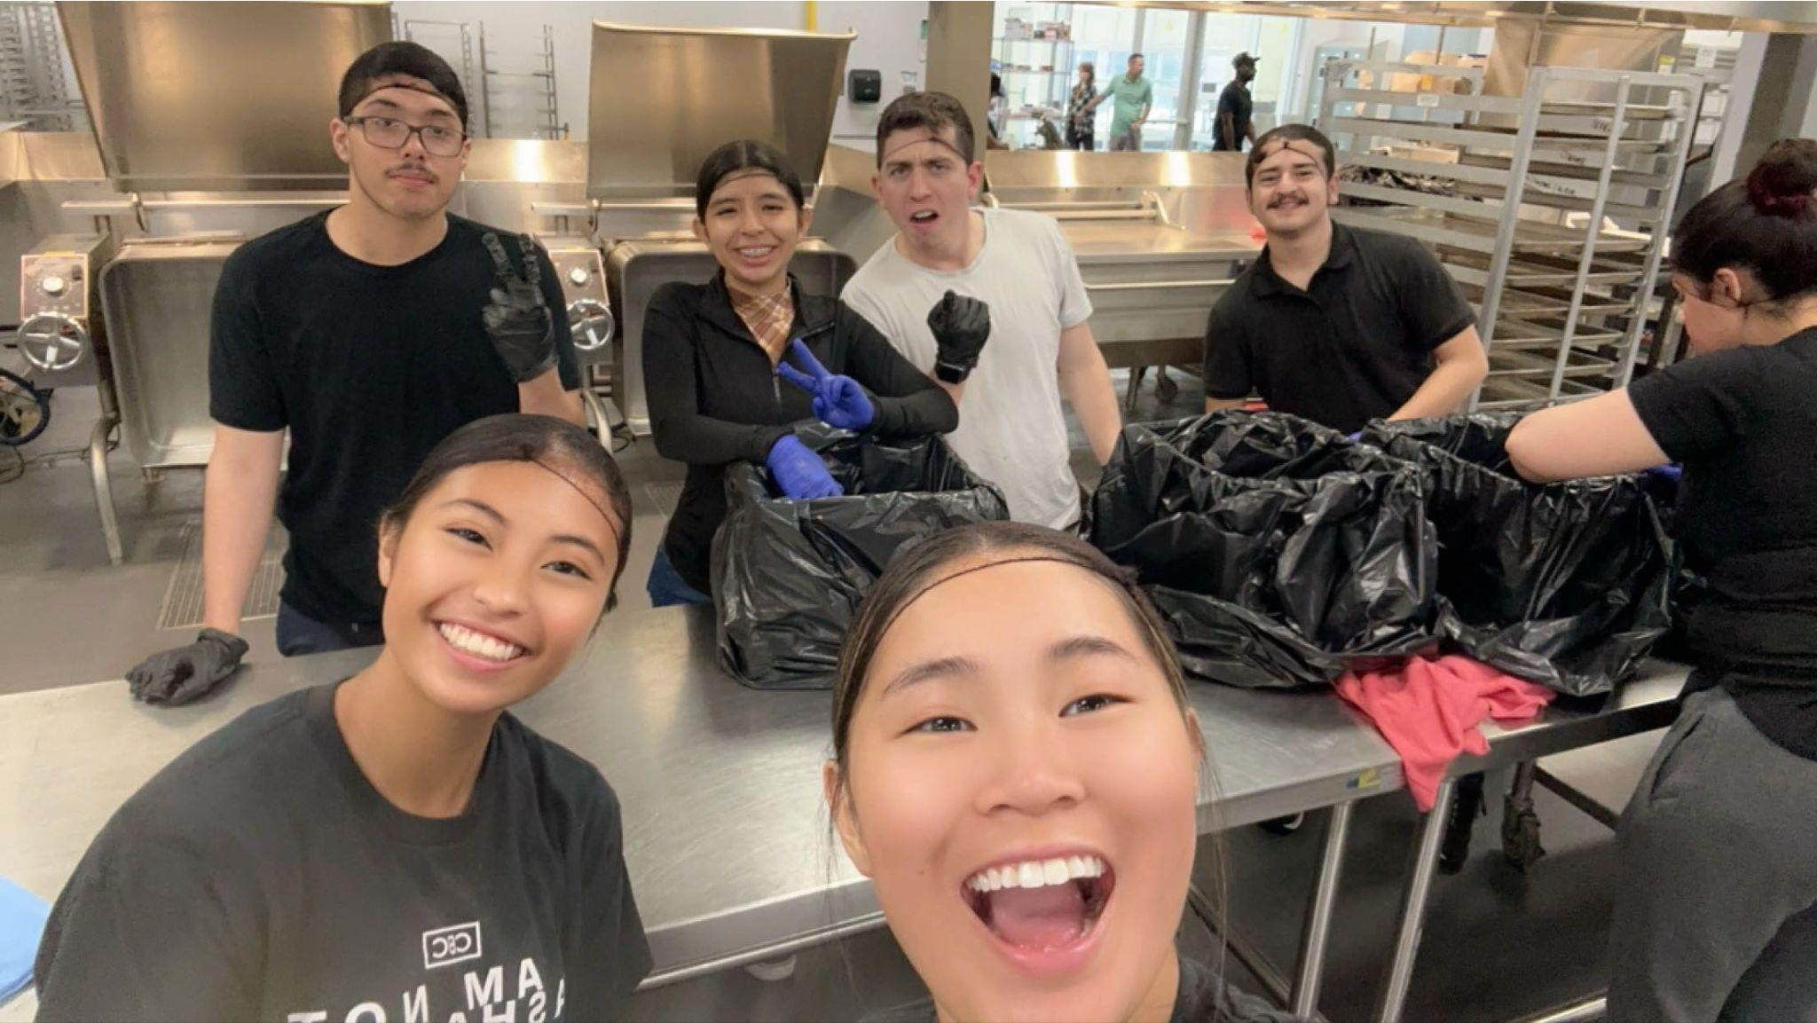
Silver Wings
Knowledge, Wisdom, and the Courage to Serve.
“Knowledge, Wisdom, and the Courage to Serve.”
QR Code

Slide 7
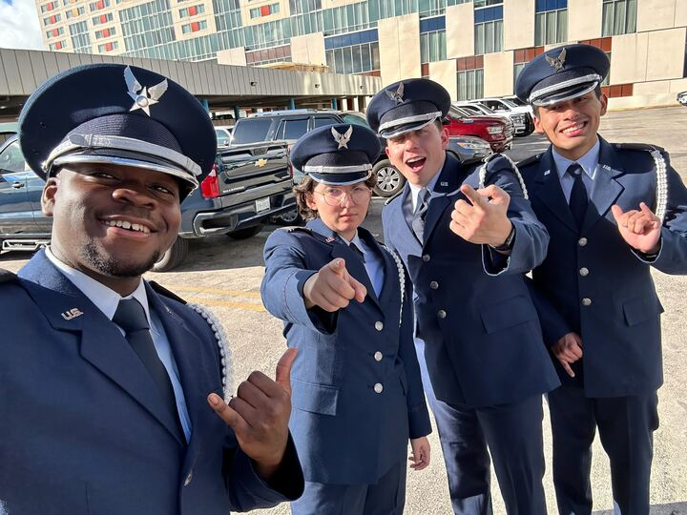
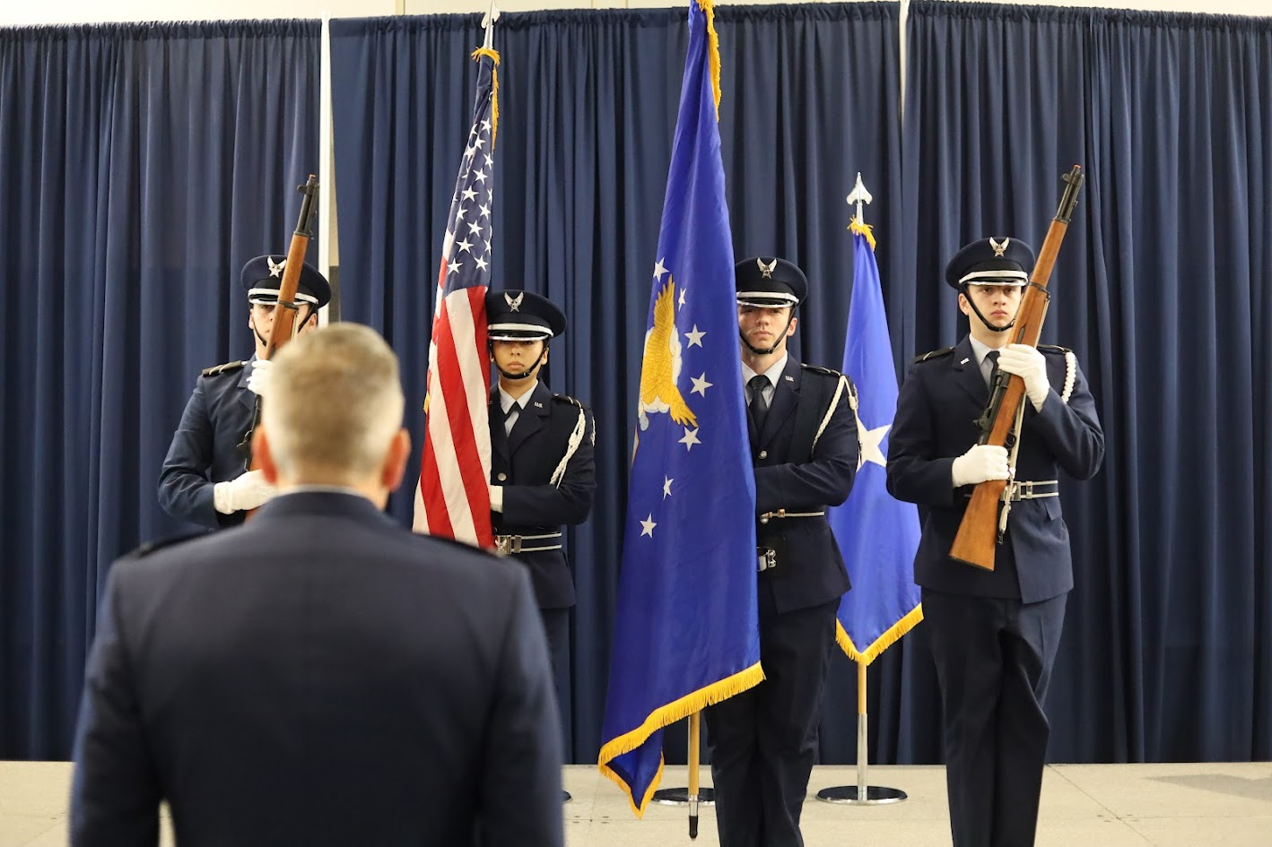
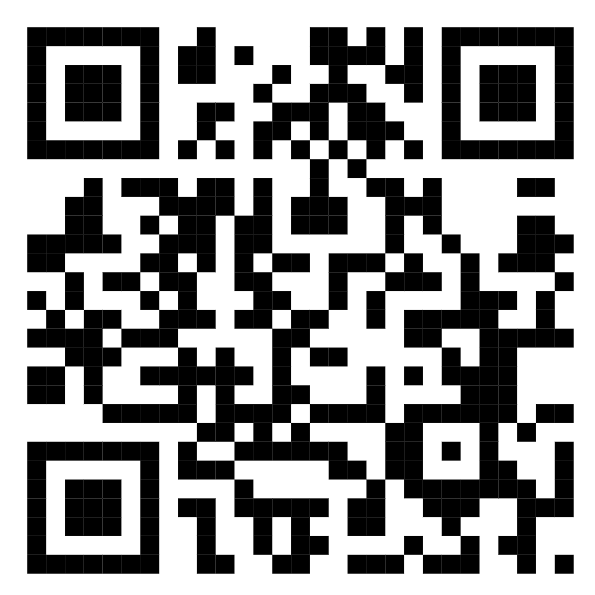
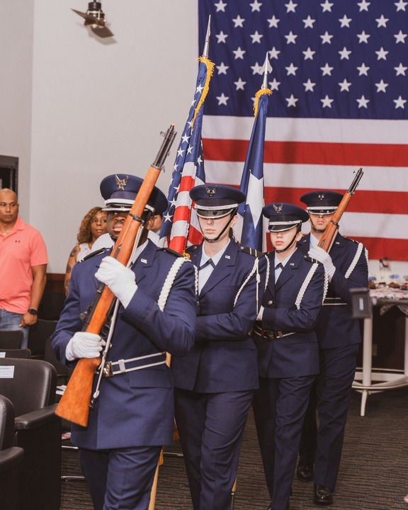
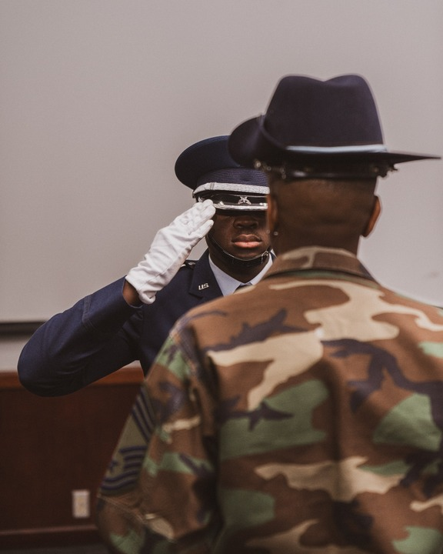
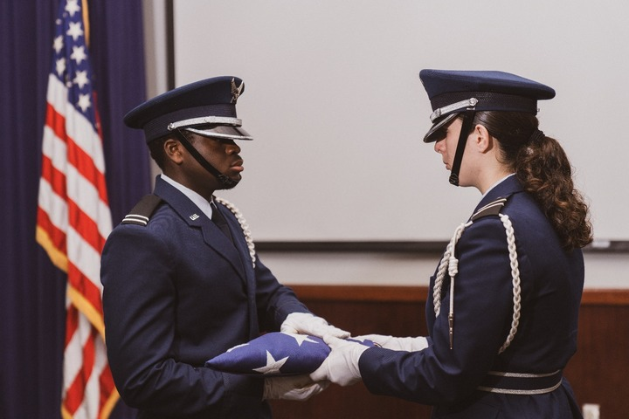
Honor Guard
Air Force ROTC Honor Guard is an opportunity for GMC cadets to gain leadership experience while representing and honoring Air Force veterans. Honor Guard teaches discipline through drill and organization.
Air Force ROTC Detachment 842 • We Build Exceptional Officers • The University of Texas at San Antonio

Slide 8
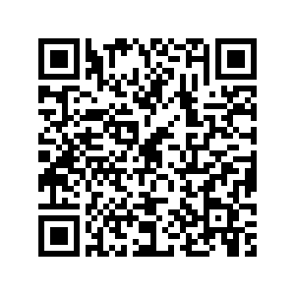
More Information?
JOIN THE DETACHMENT 842 SLACK CHANNEL
‹#›
Air Force ROTC Detachment 842 • We Build Exceptional Officers • The University of Texas at San Antonio

Slide 9
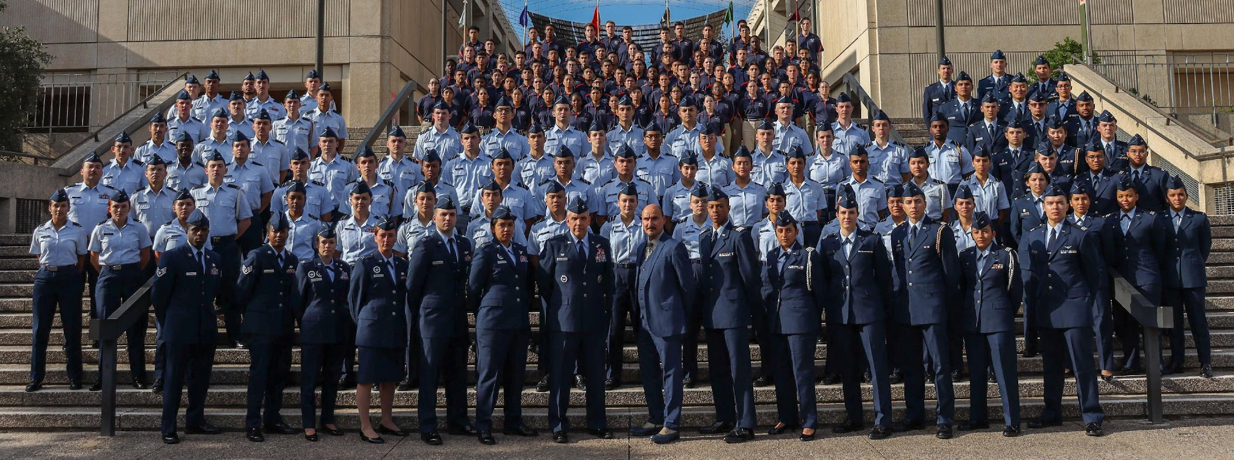
Air Force ROTC Detachment 842
The University of Texas at San Antonio
Det 842 – Best in Blue

